Slide 1
Nevada Grasshoppers & Mormon Crickets 2017
Jeff B. Knight, Entomologist
Alana Wild, APHIS-PPQ SPHD
Curtis Irwin, Ag Inspector IV

Slide 2
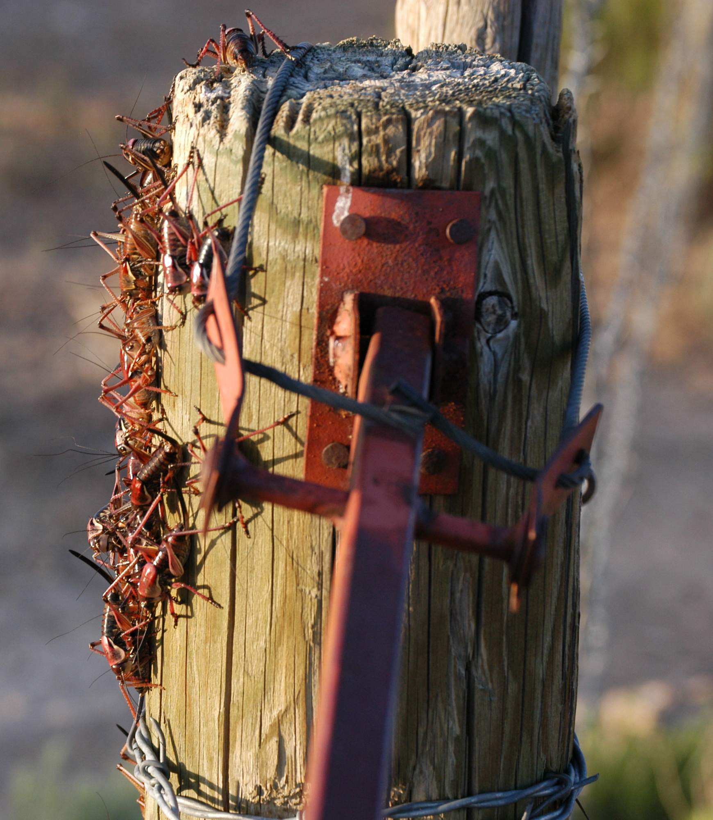
Nevada Grasshoppers & Mormon Crickets 2017
Summary
1507 sites were visited
No land was treated for Mormon crickets or grasshoppers in 2017
Put a photo here!

Slide 3
Nevada Grasshoppers & Mormon Crickets 2017

Slide 4
Nevada Grasshoppers & Mormon Crickets 2017

Slide 5
Nevada Grasshoppers & Mormon Crickets 2017
Concerns for 2018
Sage Grouse and T&E species
Lack of Populations – infrastructure issues
Weird Winter Weather….1st survey Jan 3..

